Slide 1
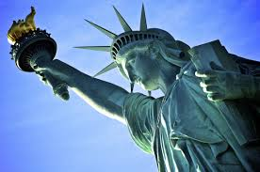
Catholic Teach-In on Migration
El Diálogo Católico sobre Migracion
June 9, 2017
Location of the CTOM

Slide 2
Thank you! ¡Gracias!
Blessed Trinity Catholic Church Parish
Congress of Day Laborers
Archdiocesan Office of Racial Harmony
Catholic Charities Archdiocese of New Orleans

Slide 3
Goals of Catholic Teach-In on Migration:
To provide an opportunity to listen and learn about the migration experience of local immigrants from Latin America.
To learn what the Catholic Church teaches on migration and seeking refuge.
To discern how one is being called to respond to our nation’s immigration crisis.

Slide 4
Opening Prayer (blue/azul)
Prayer for Those Who Migrate
Mary knew the weariness
Of the journey;
To Bethlehem, To Egypt,
Back to Nazareth.
She knew the weariness,
The fear, the longing for home,
The need to continue moving, moving,
The longing for journey's end,
the longing for at least
a semblance of a home.
To Mary we entrust
The mothers, the fathers, the children
who today are holy families
Migrating in hope, in fear, in longing,
for peace, for some security,
For something like a home.
May they find their journey's end
as we open ourselves to their stories,
their need, their spirits;
We ask for mercy
for all migrants
and for our communities
who are challenged to welcome them,
to give them hope for a new life.
--by Jane Deren, Education for Justice
Oración por quienes migran.
María sabía el cansancio
Del viaje;
A Belén, a Egipto,
De vuelta a Nazaret.
Ella sabía el cansancio,
El miedo, el anhelo de la casa,
La necesidad de seguir moviendo, moviendo,
El anhelo de la final del viaje,
el anhelo por al menos
una apariencia de un hogar.
A María le encomendamos
Las madres, los padres, los niños
que hoy son santas familias
Migrando en la esperanza, en el miedo, en anhelo,
por la paz, por un poco de seguridad,
Por algo parecido a un hogar.
Que puedan encontrar el final de su jornada
ya que nos abrimos a sus historias, \sus necesidades, sus espíritus;
Pedimos misericordia
para todos los migrantes
y para nuestras comunidades
que son retados a darles la bienvenida,
para darles esperanza para una nueva vida.
-por Jane Deren, Educación para la justicia

Slide 5
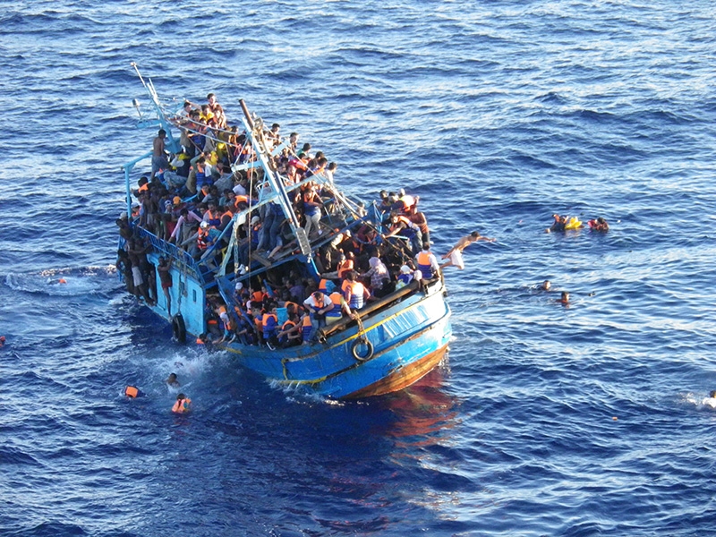
Migrant Deaths Rising in Mediterranean Sea

Slide 6
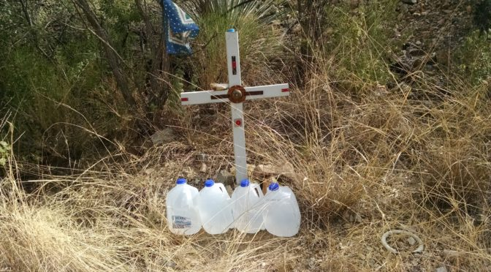
Migrant Deaths Along US/Mexico Border

Slide 7
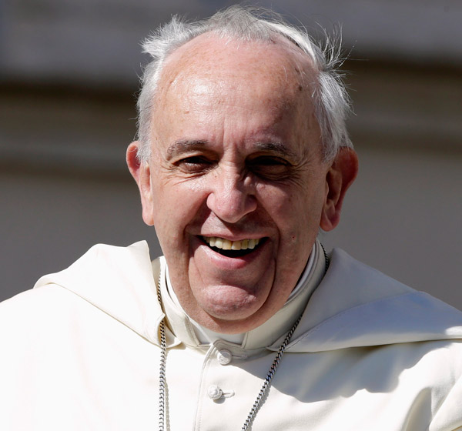
Pope’s Call for “Globalization of Charity” to protect migrants

Slide 8
Pope’s Message for World Day of Migrants and Refugees, 2014
“A change of attitude towards migrants and refugees is needed on the part of everyone, moving away from attitudes of defensiveness and fear, indifference and marginalization—all typical of a throwaway culture—towards attitudes based on a culture of encounter, the only culture capable of building a better, more just and fraternal world.”

Slide 9
Old Testament
Leviticus 19: 33-34
“When an alien resides with you in your land, you shall not oppress the alien. The alien who resides with you shall be to you as the citizen among you; you shall love the alien as yourself, for you were once aliens in the land of Egypt.”

Slide 10
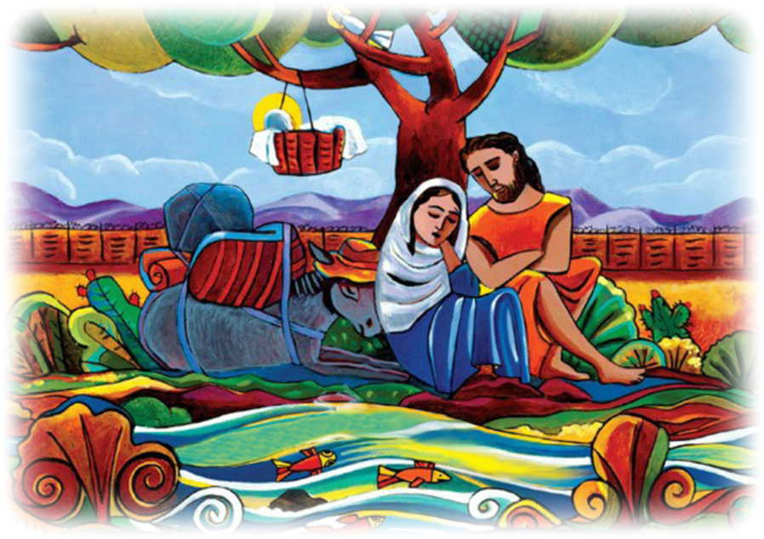

Slide 11
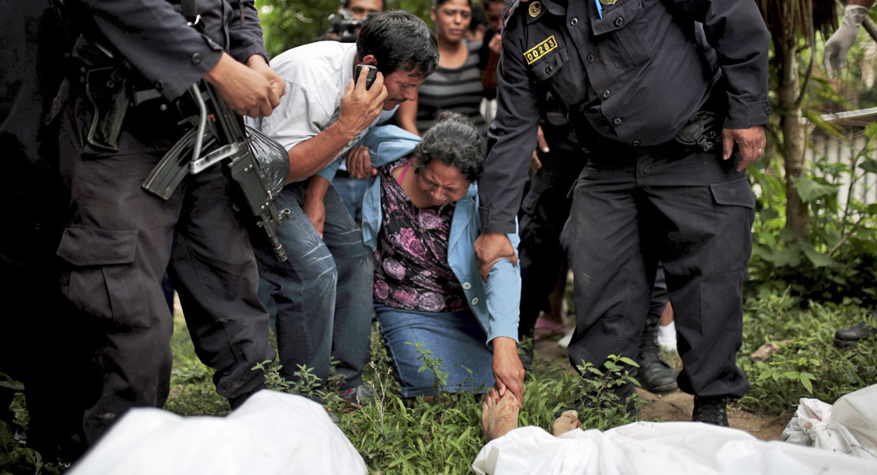
Violence in Central America

Slide 12
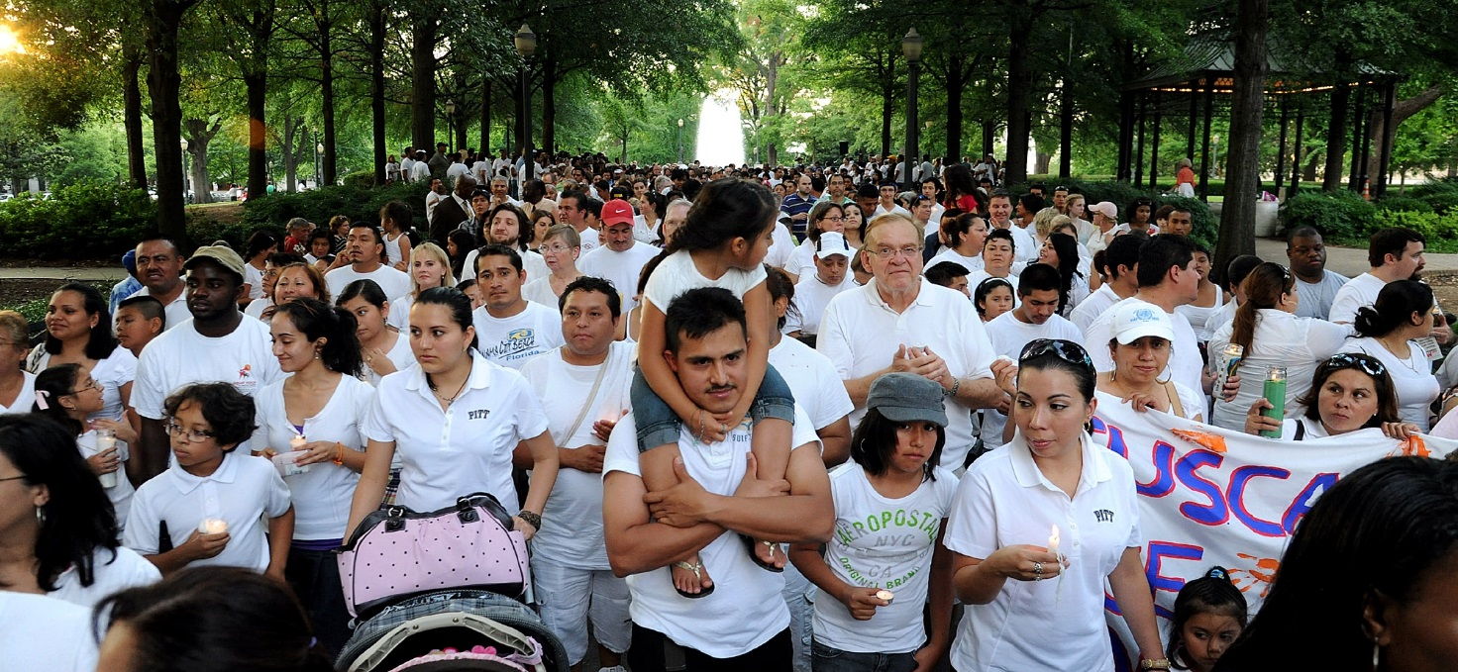
Our Nation’s Immigration Crisis
About 11 million undocumented persons in U.S.-- with almost no way to legalize status
5.0% of labor force, 4% of total population
Notes:
See http://www.pewhispanic.org/2016/09/20/overall-number-of-u-s-unauthorized-immigrants-holds-steady-since-2009/#recent-arrivals-a-smaller-share-of-u-s-unauthorized-immigrants

Slide 13
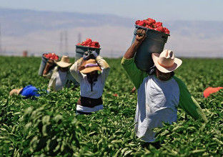
Our Nation’s Immigration Crisis
An estimated 50% to 70% of farmworkers are undocumented
Notes:
https://www.washingtonpost.com/lifestyle/food/in-an-immigration-crackdown-who-will-pick-our-produce/2017/03/17/cc1c6df4-0a5d-11e7-93dc-00f9bdd74ed1_story.html?utm_term=.9d0b9da5105f

Slide 14
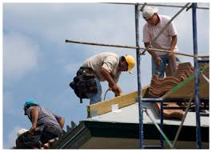
Our Nation’s Immigration Crisis
Approximately 15% of U.S. construction force is undocumented
Notes:
http://www.pewhispanic.org/2016/11/03/occupations-of-unauthorized-immigrant-workers/

Slide 15
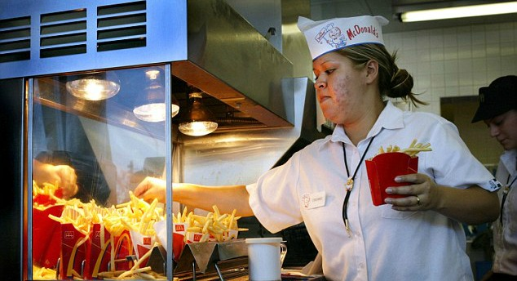
Our Nation’s Immigration Crisis
Approximately 9% of U.S. service
workforce is undocumented
Notes:
http://www.pewhispanic.org/2016/11/03/occupations-of-unauthorized-immigrant-workers/

Slide 16
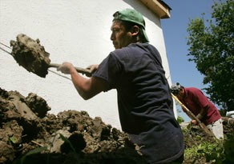
New Orleans Reconstruction Workforce
Many reconstruction workers after Hurricane Katrina were Latino, and many of those workers were undocumented.

Slide 17
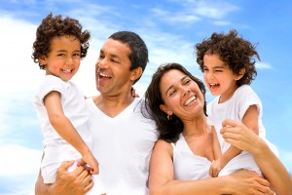
Our Nation’s Immigration Crisis
Two-thirds (66%) of unauthorized immigrant adults have lived in U.S. for 10 or more years.
Almost 40% of adult undocumented immigrants are parents of U.S. citizen children

Slide 18
“Why didn’t they come legally?”
Immigration System is badly outdated:
Almost no employment visas for persons without a college degree, despite our need for “low-skilled” labor
One must have a close U.S. citizen relative (e.g. spouse, parent, or adult child) to receive an immigrant family visa.
Immigration Reform has been stalled in Congress

Slide 19
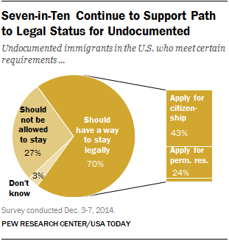
Vast Majority of Americans Support a Path to Legal Status
Notes:
Of 70%: Most of those who support legal status think there should be a way for unauthorized immigrants to become citizens (43% overall), while 24% say the path should only include permanent residency

Slide 20
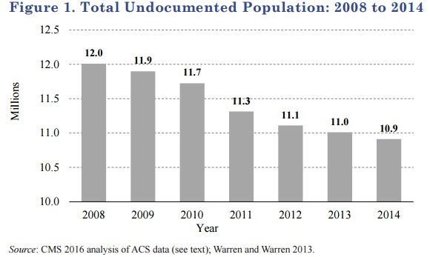
Decrease in Undocumented Immigration Population

Slide 21
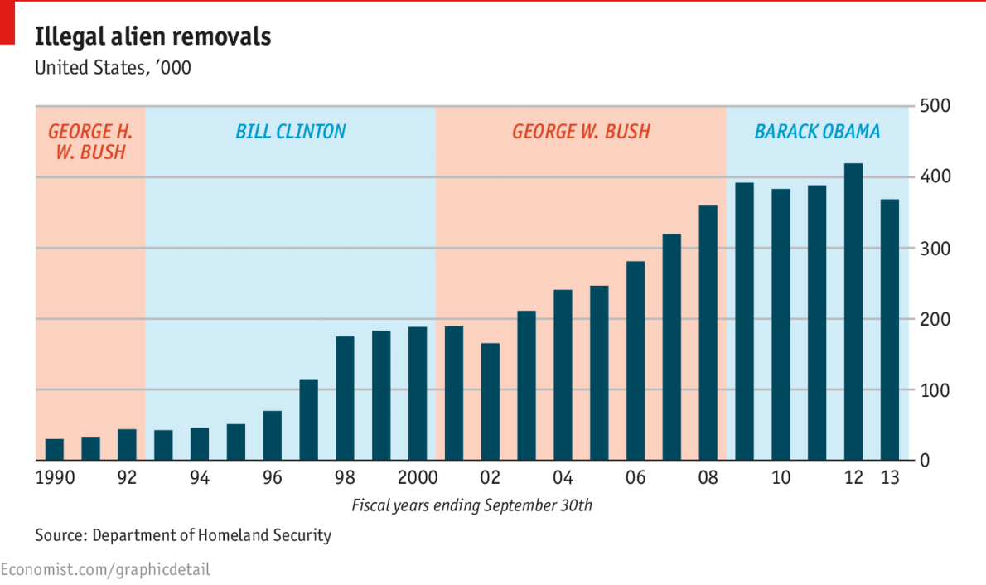
Our Nation’s Immigration Crisis
Meanwhile deportations are at an all time high: The Obama Administration deported more than 2 million immigrants.

Slide 22
Trump’s Executive Orders on Immigration
Rescind existing immigration enforcement priorities– almost everyone is now a priority
Promote local law enforcement to do work of federal immigration agents
Require detention of everyone seeking asylum at U.S./Mexico Border
Immediate deportation for anyone who cannot prove they have been in the U.S. 2+ years

Slide 23
Testimony of Local Immigrant(s)

Slide 24
Church’s Principles on Migration VALORES FUNDAMENTALES DE LAS ENSEÑANZAS DE LA IGLESIA CATOLICA SOBRE MIGRACION (orange/naranja)
Persons have the right to find opportunities in their homeland. Las personas tienen el derecho de encontrar oportunidades en su tierra natal.
Persons have the right to migrate to support themselves and their families. Las personas tienen el derecho de emigrar para mantenerse a sí mismas y a sus familias
Sovereign nations have the right to control their borders. More powerful economic nations have a stronger obligation to accommodate migrant flows. Los Estados soberanos poseen el derecho de controlar sus fronteras. Las naciones cuyo poderío económico sea mayor, cuentan con una obligación mayor de adaptarse a los flujos migratorios.

Slide 25
Church’s Principles on Migration VALORES FUNDAMENTALES DE LAS ENSEÑANZAS DE LA IGLESIA CATOLICA SOBRE MIGRACION (orange/naranja)
Refugees and asylum seekers should be afforded protection. Debe protegerse a quienes busquen refugio y asilo
The human dignity and the human rights of undocumented immigrants should be respected. Debe protegerse a quienes busquen refugio y asilo

Slide 26
Testimony of Local Immigrant(s)

Slide 27
Immigration Myths (see folder)
Please see hand-out from United States Conference of Catholic Bishops in your folder:
“Myths About Immigration”
Immigrants do not cause increase in crimes.
Most undocumented Immigrants pay taxes but are NOT eligible for Food Stamps, Medicaid, Social Security, Medicare, ACA, etc.
Undocumented Immigrants contribute $9 Billion/year to Social Security Trust Fund

Slide 28
Listening Sessions
Listening is an act of love and care. I will listen respectfully and constructively (i.e., no side conversations, no interruptions).
God frequently speaks through the unfamiliar and different. I will listen intently in order to fully understand a different point of view, realizing how this well help with my own evolving journey.
If asked to keep something confidential, I will honor the request. In conversations outside the group I won’t attribute particular statements to particular individuals by name or identifying information without permission.
I will remember that we are in a faith-based setting, and that our purpose is to build understanding among members of the Body of Christ, and I will participate in a way that builds the Christian community.

Slide 29
Share feelings in 1 or 2 sentences
Could you please share with your group what you are feeling right now in one or two sentences?
Si usted sea movido a hacerlo, comparten unas palabras con los demás en su grupo.

Slide 30
Ideas for Action/ Ideas para acción
See handout:
“Ideas for Action”
and
Letter to State’s Members of Congress
and
Sign-Up for Email Advocacy List

Slide 31
Church Teaching from Pope Francis
Church Teaching
Let us hear what Pope Francis is saying to us as Catholics about our response to migrants, the strangers in our midst:
Every human being is a child of God! He or she bears the image of Christ! We ourselves need to see, and then to enable others to see, that migrants and refugees do not only represent a problem to be solved, but are brothers and sisters to be welcomed, respected and loved. They are an occasion that Providence gives us to help build a more just society, a more perfect democracy, a more united country, a more fraternal world and a more open and evangelical Christian community.

Slide 32
Closing Prayer/Oración conclusiva
Jesus, friend of the Stranger,
Inspire us to be ministers of the Gospel and to see our neighbors in the strangers we meet.
Teach us what it means to love the strangers as we love ourselves.
Forgive us for our selfishness, for our silence when we witness someone being mistreated.
Grant us open arms and open hearts to receive your children trying to find the way to a new life-giving home.
Help us end the misery of children separated from family, of mothers separated from husbands by man-made borders, but not by love.
May they arrive, as you did, to joy and to the benediction of a loving embrace.
Amen.
Jesús, amigo del extranjero, nos inspiras a ser ministros del Evangelio y a ver a nuestros vecinos en los extraños que nos encontramos.
Enséñenos lo que significa amar a los extraños como nos amamos nosotros mismos.
Perdónanos por nuestro egoísmo, por nuestro silencio cuando vemos a alguien siendo maltratados.
Concédanos brazos abiertos y corazones abiertos para recibir a sus hijos que tratan de encontrar el camino hacia una nueva casa vivificante.
Ayudarnos a acabar con la miseria de niños separados de sus familias, de las madres separadas de sus maridos por la frontera artificial, pero no por el amor.
Que puedan llegar, como lo hiciste, a la alegría y la bendición de un abrazo

Slide 33
Evaluations/Evaluaciones
Evaluations

